Slide 1
Statistics

Slide 2
Data we normally encounter..
Price Quoted | Vehicle Type | Year Of Registration | Gearbox | PowerPS | kilometers Run | Fuel Type | Brand | Any Damage
4450 | limousine | 2003 | manual | 150 | 150000 | diesel | bmw
13299 | suv | 2005 | manual | 163 | 150000 | diesel | volvo | no
3200 | bus | 2003 | manual | 101 | 150000 | diesel | volkswagen
4500 | small car | 2006 | manual | 86 | 60000 | petrol | seat | no
18750 | suv | 2008 | automatic | 185 | 150000 | diesel | volvo | no
988 | limousine | 1995 | manual | 90 | 150000 | petrol | volkswagen | no
400 | station wagon | 1996 | manual | 0 | 150000 | petrol | opel
1399 | coupe | 1997 | manual | 136 | 150000 | petrol | mercedes_benz | no
4680 | station wagon | 2005 | manual | 122 | 150000 | petrol | opel | no
8340 | limousine | 2005 | automatic | 140 | 125000 | diesel | skoda | no
1870 | limousine | 2001 | manual | 82 | 150000 | petrol | mercedes_benz | no
2500 | coupe | 2001 | manual | 105 | 125000 | petrol | opel | no
990 | small car | 2001 | manual | 68 | 150000 | petrol | toyota | no
3000 |  | 2016 | manual | 116 | 150000 | petrol | bmw | yes
2200 | limousine | 2003 | manual | 83 | 125000 | petrol | opel | no
1600 | station wagon | 1999 | manual | 140 | 150000 | diesel | volvo | no
1300 | suv | 1993 | manual | 101 | 150000 | diesel | nissan | yes
4100 | others | 2002 | manual | 125 | 150000 | diesel | others
600 | small car | 1998 | manual | 75 | 150000 | petrol | volkswagen | yes
698 |  | 2017 |  | 0 | 150000 |  | volkswagen
680 | limousine | 1992 | manual | 88 | 150000 | petrol | mazda | no

Slide 3
Purposes of Statistics
Descriptive Statistics
Organize
Summarize
Simplify
Presentation of data
Inferential Statistics
Generalize from samples to populations
Hypothesis testing
Predictive Analysis
Relationships among variables
Describing sample data
Make population predictions

Slide 4
The need for Descriptive Statistics
To summarize data for easier comprehension
To Understand the quality of our data
To decide on appropriate statistical models, and the variables to be specified in the model

Slide 5
Types of Data
Nominal
Ordinal
Interval
Ratio
Gender: M/F
Country of Origin
Categorical, Non-Metric, Qualitative (Unordered, Ordered)
Class Rank: 1,2,3
Satisfied? Very, Somewhat…
Temperature: 30,40
Year of Purchase
Continuous, Metric, Quantitative
Price
Weight

Slide 6
To begin, not all data are of the same type
Nominal
(Many Categories)
Interval
Nominal
(two categories)
Ratio
Nominal
Ratio
Price Quoted | Vehicle Type | Year Of Registration | Gearbox | PowerPS | kilometers Run | Fuel Type | Brand | Any Damage
4450 | limousine | 2003 | manual | 150 | 150000 | diesel | bmw
13299 | suv | 2005 | manual | 163 | 150000 | diesel | volvo | no
3200 | bus | 2003 | manual | 101 | 150000 | diesel | volkswagen
4500 | small car | 2006 | manual | 86 | 60000 | petrol | seat | no
18750 | suv | 2008 | automatic | 185 | 150000 | diesel | volvo | no
988 | limousine | 1995 | manual | 90 | 150000 | petrol | volkswagen | no
400 | station wagon | 1996 | manual | 0 | 150000 | petrol | opel
1399 | coupe | 1997 | manual | 136 | 150000 | petrol | mercedes_benz | no
4680 | station wagon | 2005 | manual | 122 | 150000 | petrol | opel | no
8340 | limousine | 2005 | automatic | 140 | 125000 | diesel | skoda | no
1870 | limousine | 2001 | manual | 82 | 150000 | petrol | mercedes_benz | no
2500 | coupe | 2001 | manual | 105 | 125000 | petrol | opel | no
990 | small car | 2001 | manual | 68 | 150000 | petrol | toyota | no
3000 |  | 2016 | manual | 116 | 150000 | petrol | bmw | yes
2200 | limousine | 2003 | manual | 83 | 125000 | petrol | opel | no
1600 | station wagon | 1999 | manual | 140 | 150000 | diesel | volvo | no
1300 | suv | 1993 | manual | 101 | 150000 | diesel | nissan | yes
4100 | others | 2002 | manual | 125 | 150000 | diesel | others
600 | small car | 1998 | manual | 75 | 150000 | petrol | volkswagen | yes
698 |  | 2017 |  | 0 | 150000 |  | volkswagen
680 | limousine | 1992 | manual | 88 | 150000 | petrol | mazda | no

Slide 7
Descriptive Statistics

Slide 8
Statistics – Single variable
Three important defining characteristics of any set of data for a given variable are:
Shape of Data (Also called Distribution)
Measure of Location (Also called Central Tendency)
Spread of data ( Also called Variability)

Slide 9
An example
A mobile phone maker claims that the battery in their brand of mobile phone will last 48 hours, under normal usage conditions.
The QC department at their manufacturing facility, tests this claim routinely using randomly selected mobile phones.
The data for the just concluded tests on one fine day, has just arrived…

Slide 10
An example
It is impossible to expect that each battery would last exactly 48 hours. There is bound to be variability in the life of the battery. This variability can be due to variabilities in the quality of input components, manufacturing conditions, workers involved, or just unexplainable random fluctuations
So, the claim that we need to verify is:
On an average, does a mobile phone battery (made by this company) last for 48 Hrs?
To verify this claim, it will be impossible to test the entire output (Population)
We will need to devise a method of sampling to obtain a sample of phones and test them.
We need to understand what the sample data indicates (Descriptive Statistics)
We need to conclude about the population battery life (Inferential Statistics)

Slide 11
Data
Thirty batteries were tested, and we have the number of hours the battery lasted for each of the battery
Sample # | Hrs | Sample # | Hrs | Sample # | Hrs
1 | 55 | 11 | 45 | 21 | 39
2 | 46 | 12 | 50 | 22 | 52
3 | 52 | 13 | 68 | 23 | 33
4 | 51 | 14 | 54 | 24 | 51
5 | 48 | 15 | 46 | 25 | 54
6 | 50 | 16 | 48 | 26 | 59
7 | 27 | 17 | 47 | 27 | 42
8 | 53 | 18 | 44 | 28 | 49
9 | 57 | 19 | 49 | 29 | 56
10 | 50 | 20 | 62 | 30 | 53
Lets say the 30 batteries were made in three different plants (A,B,C), and we had the data related to that..
Plant | # of Samples
A | 12
B | 9
C | 9
Quantitative variable
Qualitative variable

Slide 12
Summarizing Quantitative Data - Ordering
Sample # | Hrs | Sample # | Hrs | Sample # | Hrs
1 | 55 | 11 | 45 | 21 | 39
2 | 46 | 12 | 50 | 22 | 52
3 | 52 | 13 | 68 | 23 | 33
4 | 51 | 14 | 54 | 24 | 51
5 | 48 | 15 | 46 | 25 | 54
6 | 50 | 16 | 48 | 26 | 59
7 | 27 | 17 | 47 | 27 | 42
8 | 53 | 18 | 44 | 28 | 49
9 | 57 | 19 | 49 | 29 | 56
10 | 50 | 20 | 62 | 30 | 53
Sample # | Hrs | Sample # | Hrs | Sample # | Hrs
13 | 68 | 3 | 52 | 16 | 48
20 | 62 | 22 | 52 | 17 | 47
26 | 59 | 4 | 51 | 2 | 46
9 | 57 | 24 | 51 | 15 | 46
29 | 56 | 6 | 50 | 11 | 45
1 | 55 | 10 | 50 | 18 | 44
14 | 54 | 12 | 50 | 27 | 42
25 | 54 | 19 | 49 | 21 | 39
8 | 53 | 28 | 49 | 23 | 33
30 | 53 | 5 | 48 | 7 | 27
We can now quickly read, Max = 68, Min = 27, some concentration of values around 50…

Slide 13
Summarizing Quantitative Data Ungrouped Frequency Distributions
Sample # | Hrs | Sample # | Hrs | Sample # | Hrs
13 | 68 | 3 | 52 | 16 | 48
20 | 62 | 22 | 52 | 17 | 47
26 | 59 | 4 | 51 | 2 | 46
9 | 57 | 24 | 51 | 15 | 46
29 | 56 | 6 | 50 | 11 | 45
1 | 55 | 10 | 50 | 18 | 44
14 | 54 | 12 | 50 | 27 | 42
25 | 54 | 19 | 49 | 21 | 39
8 | 53 | 28 | 49 | 23 | 33
30 | 53 | 5 | 48 | 7 | 27
Hrs | Frequency | Hrs | Frequency | Hrs | Frequency | Hrs | Frequency
X | f | X | f | X | f | X | f
68 | 1 | 57 | 1 | 46 | 2 | 35 | 0
67 | 0 | 56 | 1 | 45 | 1 | 34 | 0
66 | 0 | 55 | 1 | 44 | 1 | 33 | 1
65 | 0 | 54 | 2 | 43 | 0 | 32 | 0
64 | 0 | 53 | 2 | 42 | 1 | 31 | 0
63 | 0 | 52 | 2 | 41 | 0 | 30 | 0
62 | 1 | 51 | 2 | 40 | 0 | 29 | 0
61 | 0 | 50 | 3 | 39 | 1 | 28 | 0
60 | 0 | 49 | 2 | 38 | 0 | 27 | 1
59 | 1 | 48 | 2 | 37 | 0
58 | 0 | 47 | 1 | 36 | 0
You can see the concentration of observation values between 48 and 54 more clearly..

Slide 14
Summarizing Quantitative Data – Ungrouped Frequency Distributions - Graphical

Slide 15
Summarizing Quantitative Data Grouped Frequency Distributions
Hrs | Frequency
66 - 68 | 1
63 - 65 | 0
60 - 62 | 1
57 - 59 | 2
54 - 56 | 4
51 - 53 | 6
48 - 50 | 7
45 - 47 | 4
42 -44 | 2
39 - 41 | 1
36 -38 | 0
33 - 35 | 1
30 - 32 | 0
27 - 29 | 1
Total n | 30
Hrs | Frequency | Hrs | Frequency | Hrs | Frequency | Hrs | Frequency
X | f | X | f | X | f | X | f
68 | 1 | 57 | 1 | 46 | 2 | 35 | 0
67 | 0 | 56 | 1 | 45 | 1 | 34 | 0
66 | 0 | 55 | 1 | 44 | 1 | 33 | 1
65 | 0 | 54 | 2 | 43 | 0 | 32 | 0
64 | 0 | 53 | 2 | 42 | 1 | 31 | 0
63 | 0 | 52 | 2 | 41 | 0 | 30 | 0
62 | 1 | 51 | 2 | 40 | 0 | 29 | 0
61 | 0 | 50 | 3 | 39 | 1 | 28 | 0
60 | 0 | 49 | 2 | 38 | 0 | 27 | 1
59 | 1 | 48 | 2 | 37 | 0
58 | 0 | 47 | 1 | 36 | 0
You can see that 25 of 30 observations have a value between 42 to 59
Of Course we have lost the information on how many observations had a value of 46, 50 etc…

Slide 16
Summarizing Quantitative Data Grouped Frequency Distributions
Any grouped frequency distribution chart is not unique. There are many ways of groupings that can be made.
Hrs | Frequency | Hrs | Frequency | Hrs | Frequency | Hrs | Frequency
X | f | X | f | X | f | X | f
68 | 1 | 57 | 1 | 46 | 2 | 35 | 0
67 | 0 | 56 | 1 | 45 | 1 | 34 | 0
66 | 0 | 55 | 1 | 44 | 1 | 33 | 1
65 | 0 | 54 | 2 | 43 | 0 | 32 | 0
64 | 0 | 53 | 2 | 42 | 1 | 31 | 0
63 | 0 | 52 | 2 | 41 | 0 | 30 | 0
62 | 1 | 51 | 2 | 40 | 0 | 29 | 0
61 | 0 | 50 | 3 | 39 | 1 | 28 | 0
60 | 0 | 49 | 2 | 38 | 0 | 27 | 1
59 | 1 | 48 | 2 | 37 | 0
58 | 0 | 47 | 1 | 36 | 0
Hrs | Frequency
63 - 68 | 1
57 - 62 | 3
51 - 56 | 10
45 - 50 | 11
39 - 44 | 3
33 - 38 | 1
27 - 32 | 1
The right number of groupings and class intervals are subjective and depends on data. Anything over 10 groups becomes difficult to read and comprehend.
It is not advisable to vary the class intervals. (e.g. Hrs: 63 -68, 55 – 62, 50 – 54)

Slide 17
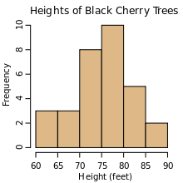
Summarizing Quantitative Data – Grouped Frequency Distributions - Graphical
Histograms
Divide the range of values in sample set into small intervals and count how many observations fall within each interval.
For each interval plot a rectangle with width = interval size and height equal to number of observations in interval

Slide 18
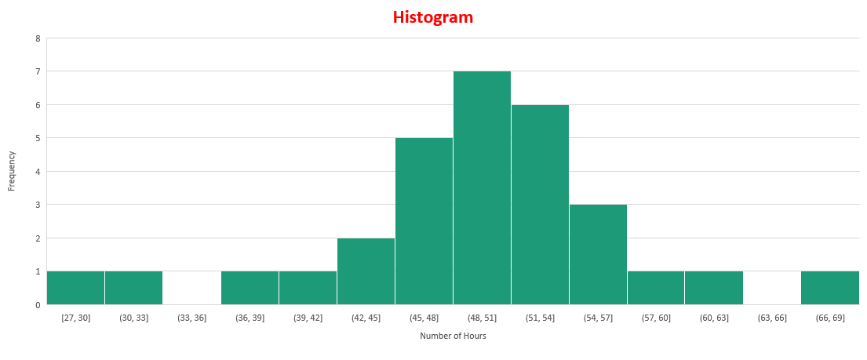
Summarizing Quantitative Data – Grouped Frequency Distributions - Graphical

Slide 19
Summarizing Quantitative Data – Relative Frequency Distributions
Hrs | Frequency
66 - 68 | 1
63 - 65 | 0
60 - 62 | 1
57 - 59 | 2
54 - 56 | 4
51 - 53 | 6
48 - 50 | 7
45 - 47 | 4
42 -44 | 2
39 - 41 | 1
36 -38 | 0
33 - 35 | 1
30 - 32 | 0
27 - 29 | 1
Total n | 30
Hrs | Frequency | Prop (f) | % f (rounded off)
66 - 68 | 1 | 0.03 | 3
63 - 65 | 0 | 0.00 | 0
60 - 62 | 1 | 0.03 | 3
57 - 59 | 2 | 0.07 | 7
54 - 56 | 4 | 0.13 | 13
51 - 53 | 6 | 0.20 | 20
48 - 50 | 7 | 0.23 | 23
45 - 47 | 4 | 0.13 | 13
42 -44 | 2 | 0.07 | 7
39 - 41 | 1 | 0.03 | 3
36 -38 | 0 | 0.00 | 0
33 - 35 | 1 | 0.03 | 3
30 - 32 | 0 | 0.00 | 0
27 - 29 | 1 | 0.03 | 3
Total n | 30 | 1.00 | 100

Slide 20
Summarizing Quantitative Data – Distributions
Hrs | Frequency
66 - 68 | 1
63 - 65 | 0
60 - 62 | 1
57 - 59 | 2
54 - 56 | 4
51 - 53 | 6
48 - 50 | 7
45 - 47 | 4
42 -44 | 2
39 - 41 | 1
36 -38 | 0
33 - 35 | 1
30 - 32 | 0
27 - 29 | 1
Total n | 30
Hrs | f | Cum. f | Cum. Prop (f) | % Cum f (rounded off)
< 69 | 1 | 30 | 1.00 | 100
< 66 | 0 | 29 | 0.97 | 97
< 63 | 1 | 29 | 0.97 | 97
< 60 | 2 | 28 | 0.93 | 93
< 57 | 4 | 26 | 0.87 | 87
< 54 | 6 | 22 | 0.73 | 73
< 51 | 7 | 16 | 0.53 | 53
< 48 | 4 | 9 | 0.30 | 30
< 45 | 2 | 5 | 0.17 | 17
< 42 | 1 | 3 | 0.10 | 10
< 39 | 0 | 2 | 0.07 | 7
< 36 | 1 | 2 | 0.07 | 7
< 33 | 0 | 1 | 0.03 | 3
< 30 | 1 | 1 | 0.03 | 3
Total n | 30

Slide 21
Summarizing Quantitative Data – Cumulative Frequency Distributions - Graphical

Slide 22
Summarizing Quantitative Data – Basic Statistical Measures- Shape of data

Slide 23
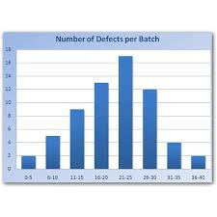
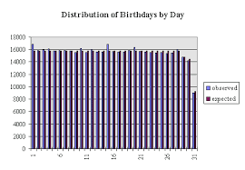
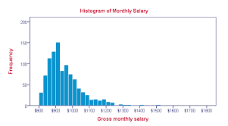
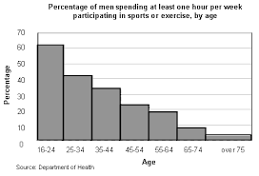
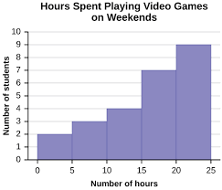
Basic Statistical Measures- Shape of data - Examples

Slide 24
Basic Statistical measures- Measure of location
The frequency distribution (tables, and graphs) help us in our understanding of data by summarizing them.
Measure of location, and dispersion simplifies it further by providing single number representations of the data
The central tendency is a score value on which a distribution tends to center
The most common measure is the average, and It signifies what is typical, usual, representative value of the data
The 3 M’s (Mean, Median, Mode)

Slide 25
Summarizing Quantitative Data – Central Tendency – Mode (and proportion)
The mode is the data value that occurs most frequently in the data set
Sample # | Hrs | Sample # | Hrs | Sample # | Hrs
13 | 68 | 3 | 52 | 16 | 48
20 | 62 | 22 | 52 | 17 | 47
26 | 59 | 4 | 51 | 2 | 46
9 | 57 | 24 | 51 | 15 | 46
29 | 56 | 6 | 50 | 11 | 45
1 | 55 | 10 | 50 | 18 | 44
14 | 54 | 12 | 50 | 27 | 42
25 | 54 | 19 | 49 | 21 | 39
8 | 53 | 28 | 49 | 23 | 33
30 | 53 | 5 | 48 | 7 | 27
Mode: 50 Hours (3/30 – 10%)
Advantages:
- Simple to compute
- Only sensible measure for qualitative data
- More appropriate for quantitative data which are inherently
discrete
Disadvantages:
There may not be a single mode (multimodal data)
It does not use all the data available
Poor sampling stability
Not very mathematically tractable

Slide 26
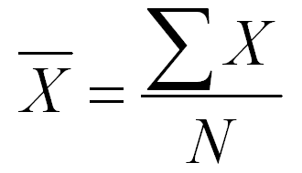
Summarizing Quantitative Data – Central Tendency – Mean
The mean is the arithmetic average of all the data values in the data set
Sample # | Hrs | Sample # | Hrs | Sample # | Hrs
13 | 68 | 3 | 52 | 16 | 48
20 | 62 | 22 | 52 | 17 | 47
26 | 59 | 4 | 51 | 2 | 46
9 | 57 | 24 | 51 | 15 | 46
29 | 56 | 6 | 50 | 11 | 45
1 | 55 | 10 | 50 | 18 | 44
14 | 54 | 12 | 50 | 27 | 42
25 | 54 | 19 | 49 | 21 | 39
8 | 53 | 28 | 49 | 23 | 33
30 | 53 | 5 | 48 | 7 | 27
Mean: 49.67 Hours
Advantages:
- Simple to compute
- Uses all the data values available in the data
- Moderate sampling stability
- Highly mathematically tractable
Disadvantages:
More sensitive to extreme values
Not appropriate for qualitative data
Not appropriate for open ended distributions
Not appropriate for skewed distributions
(29,30) , [29,30]

Slide 27
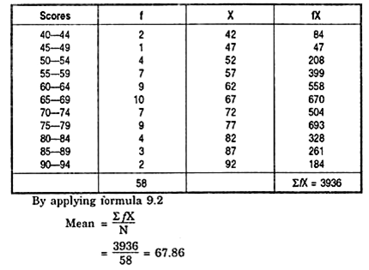
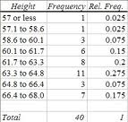
Summarizing Quantitative Data – Central Tendency – Mean – why is it not suitable for open ended distributions ?
Closed ended distribution
Open ended distribution
Source: https://www.statisticshowto.com/open-ended-distribution/
Source:https://www.yourarticlelibrary.com/education/statistics/central-tendency-in-statistics/89873

Slide 28
Summarizing Quantitative Data – Central Tendency – Median
The median is the data value in the distribution that divides the data into two groups having equal frequencies – the center point of the data set
If, n (the number of observations) is odd
Median is the data value of the ((n+1)/2)^{th} Observation, when ordered
Sample # | Hrs | Sample # | Hrs | Sample # | Hrs
13 | 68 | 3 | 52 | 16 | 48
20 | 62 | 22 | 52 | 17 | 47
26 | 59 | 4 | 51 | 2 | 46
9 | 57 | 24 | 51 | 15 | 46
29 | 56 | 6 | 50 | 11 | 45
1 | 55 | 10 | 50 | 18 | 44
14 | 54 | 12 | 50 | 27 | 42
25 | 54 | 19 | 49 | 21 | 39
8 | 53 | 28 | 49 | 23 | 33
30 | 53 | 5 | 48 | 7 | 27
If n is even, the Median is the midway point (average) of the (n/2)^{th} observation, and the (n/2 + 1)^{th} observation
In this case since we have 30 observations, the median is the average of the 15th, and 16th Observation
Median = 50 Hours

Slide 29
Summarizing Quantitative Data – Central Tendency – Median
The median is the data value in the distribution that divides the data into two groups having equal frequencies – the center point of the data set
Sample # | Hrs | Sample # | Hrs | Sample # | Hrs
13 | 68 | 3 | 52 | 16 | 48
20 | 62 | 22 | 52 | 17 | 47
26 | 59 | 4 | 51 | 2 | 46
9 | 57 | 24 | 51 | 15 | 46
29 | 56 | 6 | 50 | 11 | 45
1 | 55 | 10 | 50 | 18 | 44
14 | 54 | 12 | 50 | 27 | 42
25 | 54 | 19 | 49 | 21 | 39
8 | 53 | 28 | 49 | 23 | 33
30 | 53 | 5 | 48 | 7 | 27
Median = 50 Hours
Advantages:
- Simple to compute
- Very appropriate for skewed distributions
- Great sampling stability
- Most appropriate for open ended distributions
- Appropriate for ordered qualitative data
Disadvantages:
Does not use all data values
Less mathematically tractable compared to mean

Slide 30
Summarizing Qualitative Data – Frequency Table, Central Tendency, Bar Graph and Pie Chart
Plant | Frequency
A | 12
B | 9
C | 9
The modal value is “Plant A”, @ 40%

Slide 31
Summarizing Quantitative Data – Dispersion - Concept
Data Set 1 : 2, 6, 10, 10, 14,18 → Mean =10, Median =10, Mode =10
Data Set 2 : 1, 2, 10, 10, 18,19 → Mean =10, Median =10, Mode =10
Data Set 3 : 10,10,10,10,10,10 → Mean =10, Median =10, Mode =10
What is the difference between the three data sets?
This difference is characterized as Dispersion (or Variability between the individual data values) and is captured by measures such as Range, Inter Quartile Range, Standard Deviation, and Coefficient of Variation

Slide 32
Summarizing Quantitative Data – Dispersion - Range
The range is defined as the R = (Maximum Data value) – (Minimum Data Value)
Sample # | Hrs | Sample # | Hrs | Sample # | Hrs
13 | 68 | 3 | 52 | 16 | 48
20 | 62 | 22 | 52 | 17 | 47
26 | 59 | 4 | 51 | 2 | 46
9 | 57 | 24 | 51 | 15 | 46
29 | 56 | 6 | 50 | 11 | 45
1 | 55 | 10 | 50 | 18 | 44
14 | 54 | 12 | 50 | 27 | 42
25 | 54 | 19 | 49 | 21 | 39
8 | 53 | 28 | 49 | 23 | 33
30 | 53 | 5 | 48 | 7 | 27
Range = 68 – 27 =41
Advantages:
- Simple to compute
- Provides a quick understanding of the total spread of
the data values
Disadvantages:
Cannot be used for qualitative data
Uses only two data values and is not sensitive to majority of data values
Highly influenced by extreme data values
Poor sampling stability

Slide 33
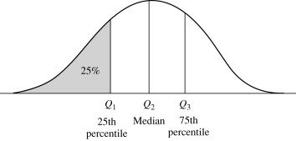
Summarizing Quantitative Data – Dispersion – Interquartile Range
The IQR is the range of the middle % 50 of the data
Sample # | Hrs | Sample # | Hrs | Sample # | Hrs
13 | 68 | 3 | 52 | 16 | 48
20 | 62 | 22 | 52 | 17 | 47
26 | 59 | 4 | 51 | 2 | 46
9 | 57 | 24 | 51 | 15 | 46
29 | 56 | 6 | 50 | 11 | 45
1 | 55 | 10 | 50 | 18 | 44
14 | 54 | 12 | 50 | 27 | 42
25 | 54 | 19 | 49 | 21 | 39
8 | 53 | 28 | 49 | 23 | 33
30 | 53 | 5 | 48 | 7 | 27
Some definitions:
Maximum (100th percentile) = Q₄
75th percentile = Q₃
Median (50th percentile) = Q₂
25th percentile = Q₁
Minimum (0th percentile) = Q₀
Range = Q₄ – Q₀
Inter Quartile Range = Q₃ – Q₁

Slide 34
Summarizing Quantitative Data – Dispersion – Interquartile Range
The IQR is the range of the middle % 50 of the data
Sample # | Hrs | Sample # | Hrs | Sample # | Hrs
13 | 68 | 3 | 52 | 16 | 48
20 | 62 | 22 | 52 | 17 | 47
26 | 59 | 4 | 51 | 2 | 46
9 | 57 | 24 | 51 | 15 | 46
29 | 56 | 6 | 50 | 11 | 45
1 | 55 | 10 | 50 | 18 | 44
14 | 54 | 12 | 50 | 27 | 42
25 | 54 | 19 | 49 | 21 | 39
8 | 53 | 28 | 49 | 23 | 33
30 | 53 | 5 | 48 | 7 | 27
Some definitions:
Maximum (100th percentile) = Q₄
75th percentile = Q₃
Median (50th percentile) = Q₂
25th percentile = Q₁
Minimum (0th percentile) = Q₀
68
54
50
46
27
Range = Q₄ – Q₀
Inter Quartile Range = Q₃ – Q₁
68 – 27 = 41
54 – 46 = 8
Advantages: Good sampling stability, Less influenced by extreme values, appropriate for skewed distributions
Disadvantages: Not computable for qualitative variables, Does not use all the data, Not amenable for further mathematical operations

Slide 35
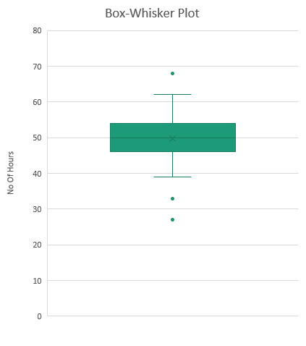
Summarizing Quantitative Data – Dispersion – Box Plots with outliers
Maximum (Q₄)
Q₃ + 1.5* IQR
Q₃
Minimum (Q₀) | 27
Q₁ | 46
Median (Q₂) | 50
Q₃ | 54
Maximum(Q₄) | 68
Median (Q₂)
Q₁
Lower Whisker (Q₁ - 1.5* IQR) | 34
Upper Whisker (Q₃ + 1.5* IQR) | 66
Q₁ - 1.5* IQR
Minimum (Q₀)

Slide 36
Summarizing Quantitative Data – Dispersion – Box Plots without outliers
Minimum (Q₀) | 27
Q₁ | 46
Median (Q₂) | 50
Q₃ | 54
Maximum(Q₄) | 68
Lower Whisker (Q₁ - 1.5* IQR) | 34
Upper Whisker (Q₃ + 1.5* IQR) | 66

Slide 37
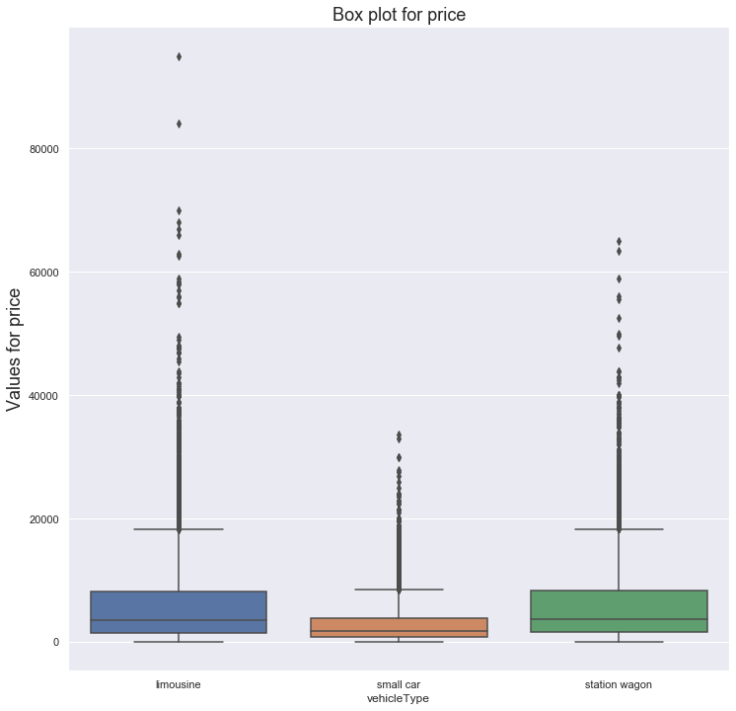
Summarizing Quantitative Data – Dispersion – Box Plots – Another Example
Measure | price ($)
 | Limousine | Small Car | Station Wagon
Count | 11874 | 9358 | 8155
Minimum | 100.00 | 100.00 | 100.00
q1 | 1500.00 | 888.00 | 1600.00
q2 (Median) | 3590.00 | 1790.00 | 3790.00
Mean | 6125.27 | 2965.30 | 6055.71
q3 | 8200.00 | 3950.00 | 8300.00
Maximum | 95000.00 | 33590.00 | 64990.00
Standard deviation | 6961.87 | 3223.10 | 6465.07

Slide 38
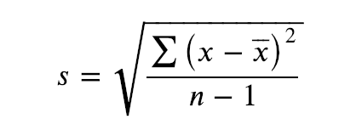
Summarizing Quantitative Data Dispersion – Standard Deviation (SD)
Standard Deviation s (for sample) is defined as
Sample # | Hrs | Sample # | Hrs | Sample # | Hrs
13 | 68 | 3 | 52 | 16 | 48
20 | 62 | 22 | 52 | 17 | 47
26 | 59 | 4 | 51 | 2 | 46
9 | 57 | 24 | 51 | 15 | 46
29 | 56 | 6 | 50 | 11 | 45
1 | 55 | 10 | 50 | 18 | 44
14 | 54 | 12 | 50 | 27 | 42
25 | 54 | 19 | 49 | 21 | 39
8 | 53 | 28 | 49 | 23 | 33
30 | 53 | 5 | 48 | 7 | 27
For the given data we can compute this as 7.81 Hrs
It has the units as the variable (Hrs in this case)
The Range of 41 Hrs can be read as, all data is covered within 5.25 Standard Deviations (41/7.81)
The IQR of 8 Hrs can be read as, the middle 50% of data is covered within 1.02 Standard Deviations (8/7.81)

Slide 39
Summarizing Quantitative Data Dispersion – Standard Deviation (SD)
Standard Deviation s (for sample), and σ (for population) is defined as
Sample # | Hrs | Sample # | Hrs | Sample # | Hrs
13 | 68 | 3 | 52 | 16 | 48
20 | 62 | 22 | 52 | 17 | 47
26 | 59 | 4 | 51 | 2 | 46
9 | 57 | 24 | 51 | 15 | 46
29 | 56 | 6 | 50 | 11 | 45
1 | 55 | 10 | 50 | 18 | 44
14 | 54 | 12 | 50 | 27 | 42
25 | 54 | 19 | 49 | 21 | 39
8 | 53 | 28 | 49 | 23 | 33
30 | 53 | 5 | 48 | 7 | 27
Advantages:
- Like mean, uses all the data values
- Has good sampling stability
- The measure is mathematically tractable
Disadvantages:
Cannot be used for qualitative data
Is influenced by extreme values/outliers
Not very appropriate for skewed data

Slide 40
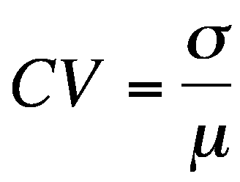
Summarizing Quantitative Data Dispersion – Coefficient of variation (CV)
CV = 5.22/10 = 0.522 (or) 52.2%
Data Set 1 : 2, 8, 10,12,18 → Mean =10, SD = 5.22
CV = 5.22/110 = 0.047 (or) 4.7%
Data Set 2 : 102, 108, 110,112,118 → Mean =110, SD = 5.22
Which data set has more variation?
Useful when comparing two distributions
Also useful when comparing two different variables (since by definition the CV is unitless)

Slide 41
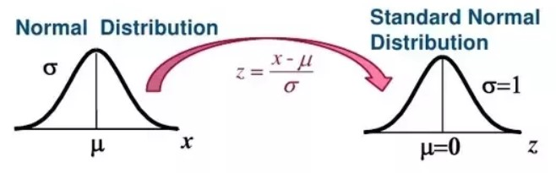
Standard normal distribution and Standard normal variate
Larsen/Farber 4th edition

Slide 42
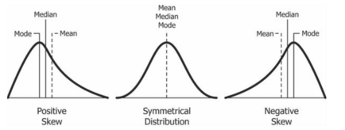
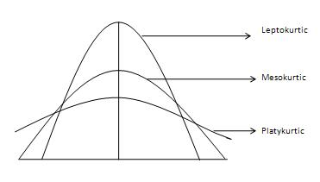
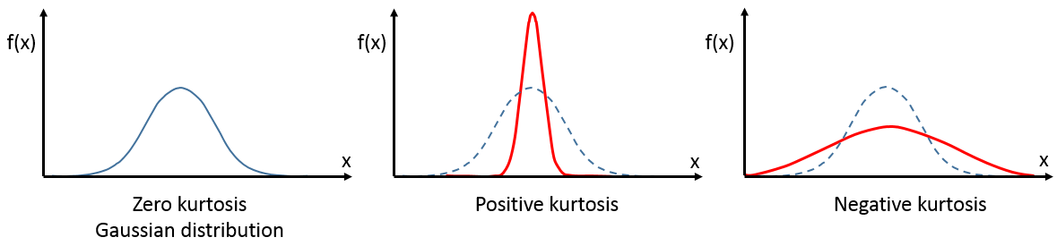
Summarizing Quantitative Data Dispersion – Skewness and Kurtosis
Skewness measures the symmetry of the distribution along the x-axis
Kurtosis measures the “peakedness” of the distribution

Slide 43

Summarizing Qualitative Data Dispersion – Index of Diversity (Gini Impurity)
Plant | Frequency
A | 12
B | 9
C | 9
Proportion
0.4
0.3
0.3
Index of Diversity = $1−\sum_{i=1}^{k}{{\text{p}\text{i} }^{2}}$
Index of Diversity = 1 – (0.4)² – (0.3)² - (0.3)² = 0.66
Plant | Frequency
A | 30
B | 0
C | 0
Proportion
1
0
0
Index of Diversity will be 0 if all the elements have come from just one plant
Plant | Frequency
A | 10
B | 10
C | 10
Proportion
1/3
1/3
1/3
Index of Diversity will be 0.667 if the elements have come in equally from all plants

Slide 44
Summarizing Qualitative Data Dispersion – Index of qualitative variation
Plant | Frequency
A | 12
B | 9
C | 9
Proportion
0.4
0.3
0.3
Index of qualitative variation =$=\frac{1−\sum_{i=1}^{k}{{\text{p}\text{i} }^{2}}}{(k−1)/k}$
Index of qualitative variation = {1 – (0.4)² – (0.3)² - (0.3)²} * 3/2 = 0.96
Plant | Frequency
A | 30
B | 0
C | 0
Proportion
1
0
0
Index of qualitative variation will be 0 if all the elements have come from just one plant
Plant | Frequency
A | 10
B | 10
C | 10
Proportion
1/3
1/3
1/3
Index of qualitative variation will be 1 if the elements have come in equally from all plants

Slide 45
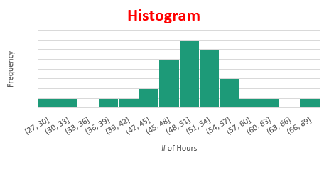
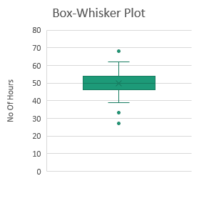
Data – Summary of..
Sample # | Hrs | Sample # | Hrs | Sample # | Hrs
1 | 55 | 11 | 45 | 21 | 39
2 | 46 | 12 | 50 | 22 | 52
3 | 52 | 13 | 68 | 23 | 33
4 | 51 | 14 | 54 | 24 | 51
5 | 48 | 15 | 46 | 25 | 54
6 | 50 | 16 | 48 | 26 | 59
7 | 27 | 17 | 47 | 27 | 42
8 | 53 | 18 | 44 | 28 | 49
9 | 57 | 19 | 49 | 29 | 56
10 | 50 | 20 | 62 | 30 | 53
Mean = 49.67 Hrs
Median =50 Hrs
Mode = 50 Hrs (10%)
S.D = 7.81 Hrs
IQR = 8 Hrs
Range = 41
CV = 15.8%

Slide 46
Data – Summary of..
Plant | Frequency
A | 12
B | 9
C | 9
Mode: Plant A (40%)
Index of diversity (or) Gini impurity = 0.64

Slide 47
Covariance and Correlation

Slide 48
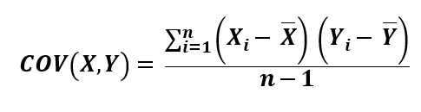
Measure of Associations
Covariance, and Correlation
Student # | Calory Intake | Weight (in Kg)
1 | 1380 | 58
2 | 1770 | 74
3 | 1640 | 71
4 | 1630 | 78
5 | 1490 | 65
Average | 1582 | 69.2
Covariance(CI&W) 1019.5

Slide 49

Measure of Associations
Covariance, and Correlation
Student # | Calory Intake | Weight (in Kg)
1 | 1380 | 58
2 | 1770 | 74
3 | 1640 | 71
4 | 1630 | 78
5 | 1490 | 65
COV(CI,W) = $\frac{\left(1380−1582\right)\left(58−69.2\right)+\left(1770−1582\right)\left(74−69.2\right)+…+(1490−1582)(65−69.2)}{5−1}$
Average | 1582 | 69.2
Covariance(CI&W) 1019.5

Slide 50
Measure of Associations - Covariance
Difficulties with Covariance – Issues of comparisons
Student # | Calory Intake | Weight (in Kg) | Kilo Calory Burnt (Exercise)
1 | 1380 | 58 | 0.2
2 | 1770 | 74 | 0.15
3 | 1640 | 71 | 0.13
4 | 1630 | 78 | 0.1
5 | 1490 | 65 | 0.17
Covariance(CI&W) | 1019.5 |  | Covariance (CB&W) | -0.224
Between Calory Intake, and Calories burnt, which is associated more with Weight?

Slide 51
Measure of Associations - Covariance
Difficulties with Covariance – Issues of comparisons
Student # | Calory Intake | Weight (in Kg) | Calory Burnt (Exercise)
1 | 1380 | 58 | 200
2 | 1770 | 74 | 150
3 | 1640 | 71 | 130
4 | 1630 | 78 | 100
5 | 1490 | 65 | 170
Between Calorie Intake, and Calories burnt, which is associated more with Weight?
Covariance(CI&W) 1019.5
Covariance (CB&W) -224

Slide 52
Measure of Associations - Covariance
Difficulties with Covariance – Issues of comparisons – Further complicated by units
Student # | Calory Intake | Weight (in Kg) | Kilo Calory Burnt (Exercise)
1 | 1380 | 58 | 0.2
2 | 1770 | 74 | 0.15
3 | 1640 | 71 | 0.13
4 | 1630 | 78 | 0.1
5 | 1490 | 65 | 0.17
Covariance(CI&W) | 1019.5 |  | Covariance (CB&W) | -0.224
Covariance is unbounded, and the value also depends on the units of data

Slide 53
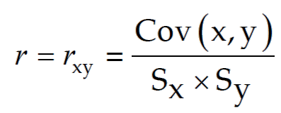
Measure of Associations - Correlations
Correlation between two variables x, y is
: Is the Pearson’s Correlation coefficient
Pearson’s correlation coefficient is:
Dimensionless, therefore comparable across different variables,
Lies between -1, and +1

Slide 54
Measure of Associations - Correlations
Student # | Calory Intake | Weight (in Kg) | Calory Burnt (Exercise)
1 | 1380 | 58 | 200
2 | 1770 | 74 | 150
3 | 1640 | 71 | 130
4 | 1630 | 78 | 100
5 | 1490 | 65 | 170
Covariance(CI&W) | 1019.5 |  | Covariance (CB&W) | -224
Correlation (CI&W) | 0.86 |  | Correlation (CB&W) | -0.94
The modulus value of the coefficient indicates the strength of relationship between two variables (Closer it is to 1, the greater the strength)
The Sign of the coefficient indicates the direction of relationship
(+) ---- Variables move in the same direction
(-) ---- Variables move in the opposite direction

Slide 55
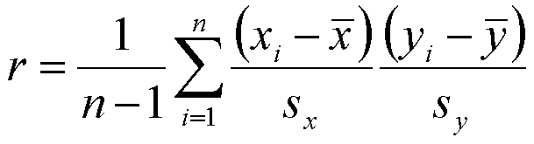
Measure of Associations - Correlations
Correlation between two variables x, y is
: Is the Pearson’s Correlation coefficient

Slide 56
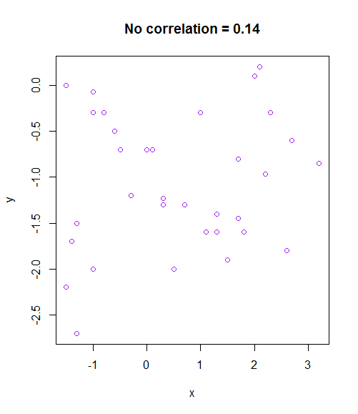
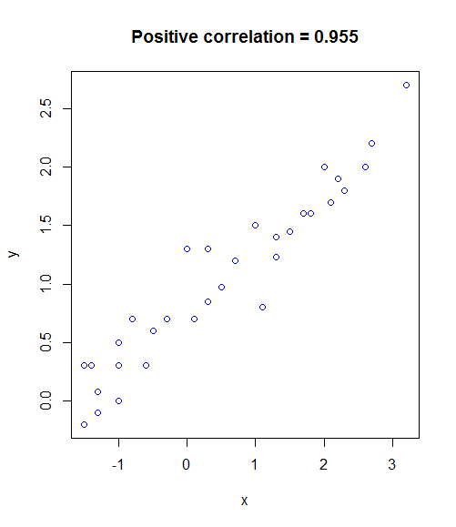
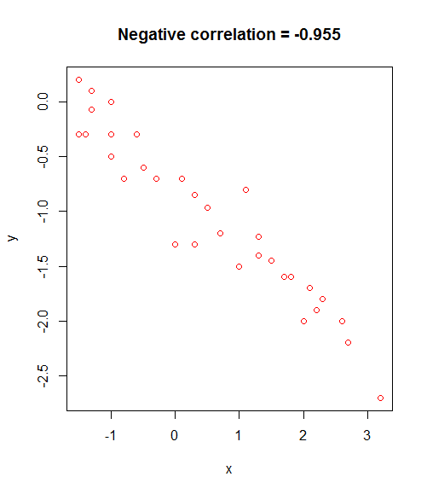
Measure of Associations - Correlations
Scatter Plot provides a good hint to the possible correlation value between two variables

Slide 57
Measure of Associations - Correlations
 | X | Y=2X
 | 1 | 2
 | 2 | 4
 | 3 | 6
 | 4 | 8
 | 5 | 10
 | 6 | 12
 | 7 | 14
 | 8 | 16
 | 9 | 18
Y = 2X + 4
6
8
10
12
14
16
18
20
22
Y=X³
1
8
27
64
125
216
343
512
729
Pearson’s Correlation coefficient provides the direction and strength of a linear relationship between two variables
Correlation
1 1 0.93

Slide 58
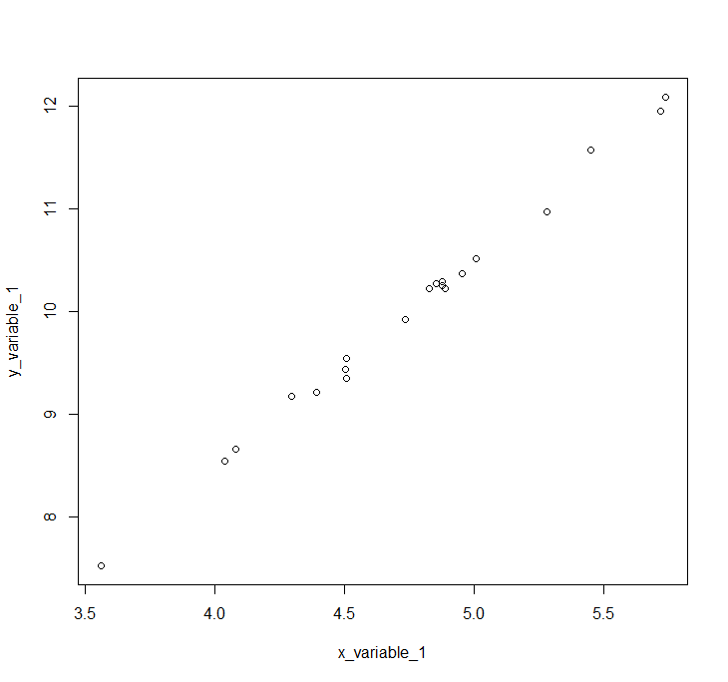
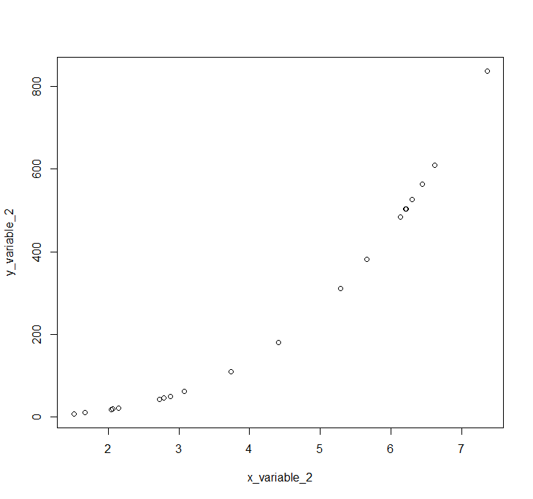
Spearman Rank Correlation
Degree of association between two variables
Linear or nonlinear association
x increases, y increases or decreases monotonically

Slide 59
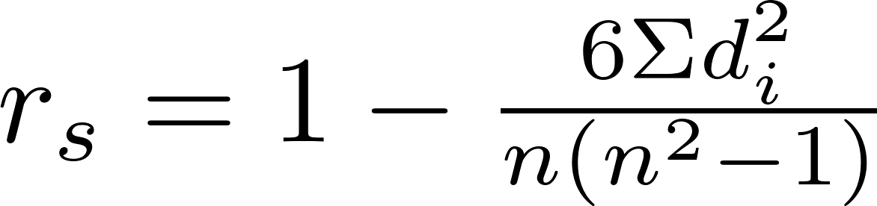
Spearman Rank Correlation
Spearman rank correlation computation for n observations:
d_{i} is the difference in the ranks given to the two variables values for each item of the data
Example:
Number | 1 | 2 | 3 | 4 | 5 | 6 | 7 | 8 | 9 | 10
X₁ | 7 | 6 | 4 | 5 | 8 | 7 | 10 | 3 | 9 | 2
Y₁ | 5 | 4 | 5 | 6 | 10 | 7 | 9 | 2 | 8 | 1
_{Rank X1} | 6.5 | 5 | 3 | 4 | 8 | 6.5 | 10 | 2 | 9 | 1
_{Rank Y1} | 4.5 | 3 | 4.5 | 6 | 10 | 7 | 9 | 2 | 8 | 1
_{d}² | 4 | 4 | 2.25 | 4 | 4 | 0.25 | 1 | 0 | 1 | 0
r_{s}=0.88

Slide 60
Spearman Rank Correlation
r_{s} takes a value between -1 (negative association) and 1 (positive association)
r_{s} = 0 means no association
Monotonically increasing r_{s} = 1 or positively correlated straight line
Monotonically decreasing r_{s} = -1 or negatively correlated straight line.
Can be used when association is nonlinear
Can be applied for ordinal variables

Slide 61
The End

